Slide 1
AWS –Virtual Private Cloud
April 2016

Slide 2
Version Sheet: MANDATORY (hidden in ‘slide show’ mode)
Version | Changes | Author
001 | Redesign | Rohan Salvi

Slide 3
Note to the SME:
Note to the SME:
This is a temporary slide and will not be part of the final upload at all. It is to help the SME understand how we will communicate changes to them.
Please read before you begin reviewing this module as SME
Dark Red box with white text
Note to the SME
The SME must provide missing info.
Amber box with black text
Note to the SME
The SME must validate the re-design/ the modification/ addition.
To Review and Navigate the comments in the presentation Click on the “Review” Tab and then Click “Next” to review all the comments . Also you can add your comments using the “New comment” button
The comments in the review section have also been updated in a green textbox with black text.
.

Slide 4
Ground Rules for Face-to-face Classrooms
Everyone participates
Respect individual opinions and diversities
Be open and honest
Give headlines, be concise
One speaker at a time
Make language a non-issue
Stick to time contracts
Seek first to understand, and then to be understood
Clean desk / room policy
No mobile phone,
No computer (except for surveys, polls etc)
Clients & Leadership are often around, please remember that
Maintain a spirit of fun and enthusiasm
Notes:
Best to print on an A3 sheet and display in class. The idea is to co-create, to connect to learn, to do-learn-do (knowing is not enough, the real purpose is to apply what we learn on the job). It would also be great to have the class share their learning with their teams. You are the facilitator, you will help all share knowledge and learn new concepts or skills, there will be no lectures, everyone is a teacher.

Slide 5

Ground Rules for Virtual Classrooms
Wait for others to finish speaking before you speak
Each time you speak, state your name
Build on others’ ideas and thoughts
Disagreeing is OK –with respect and courtesy
Participate actively in each session
Share experiences and best practices
Bring up challenges, ask questions
Discuss successes
Respond to whiteboards, polls, quizzes, chat boxes
Hang up if you need to take an urgent phone call, don’t put this call on hold
As a best practice…be just a few minutes early!
Communicate professionally with others
Mute when you’re not speaking
Be on time for each virtual session
Notes:
Show this slide and hide the one for onsite classrooms, if this is a virtual session.
ONLY for Virtual classrooms

Slide 6
Module at a Glance
SME to provide the details required in the table.
Target Audience:
Course Level: | Basic
Duration (in hours): | 30 mins
Pre-requisites, if any: | NA
Post-requisites, if any: | Submit Session Feedback
Relevant Certifications: | None

Slide 7
Introductions (for Virtual Classrooms)
SME to provide the photos and names of the facilitators.
Business Photo
Business Photo
Facilitator
Name
Role
Moderator
Name
Role
Notes:
Add pics and Capgemini roles for the Facilitator and moderator. Establish their credibility, what qualifies them to facilitate this session.

Slide 8
Course Map
What is VPC
1
Customizing VPC network
2
Default VPC vs Custom VPC
3
VPC Peering
4
5
VPC Transitive Peering

Slide 9


Module Objectives
Note to the SME : Please provide the module Objectives or validate the partially updated content
What you will learn
At the end of this module, you will learn:
What is VPC
What you will be able to do
At the end of this module, you be able to:
Explain what is VPC
Customize the Network
Understand VPC network
Describe default VPC vs Custom VPC
Describe VPC Peering & transitive Peering

Slide 10

Amazon – Virtual Private Cloud
Launch AWS resources
Selection of own IP address range
Configuration of route tables & network gateways
Creation of subnet masks

Slide 11
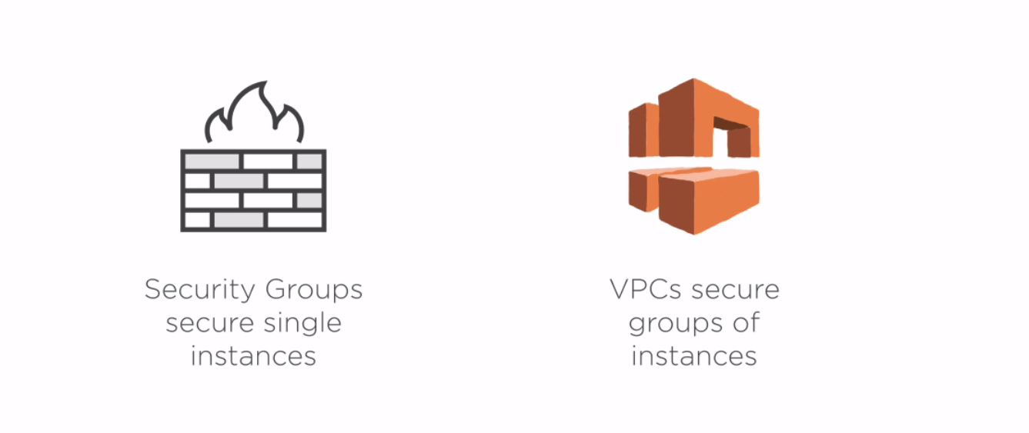
VPC

Slide 12
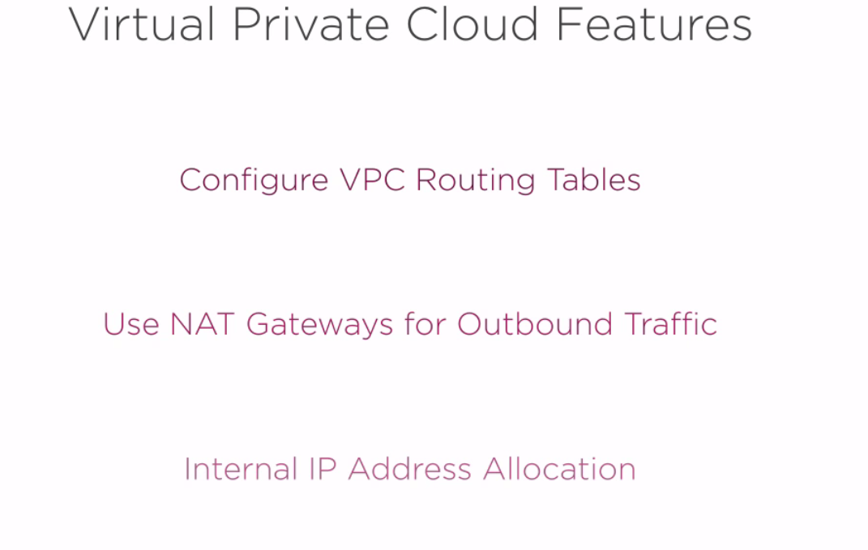
VPC

Slide 13
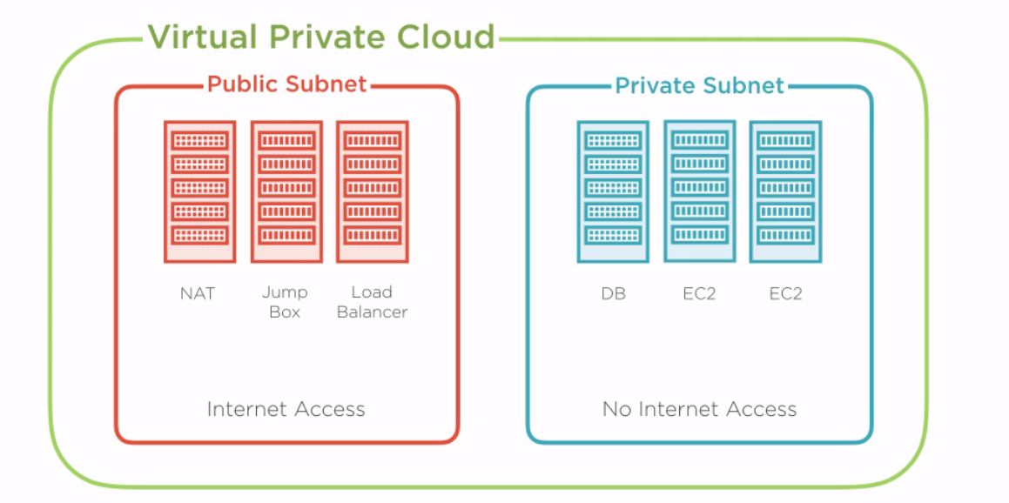
VPC

Slide 14
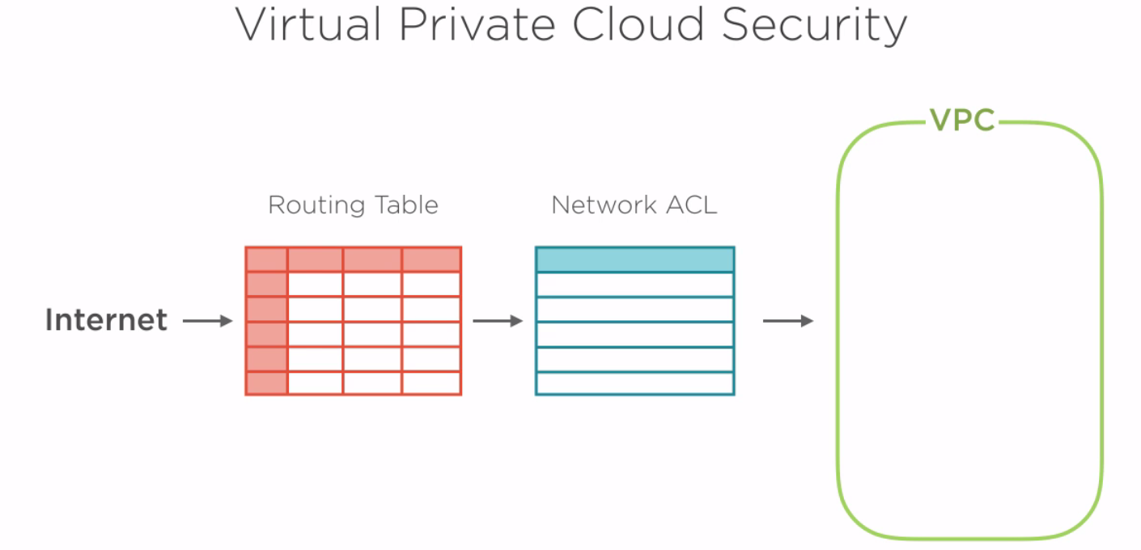
VPC Security

Slide 15
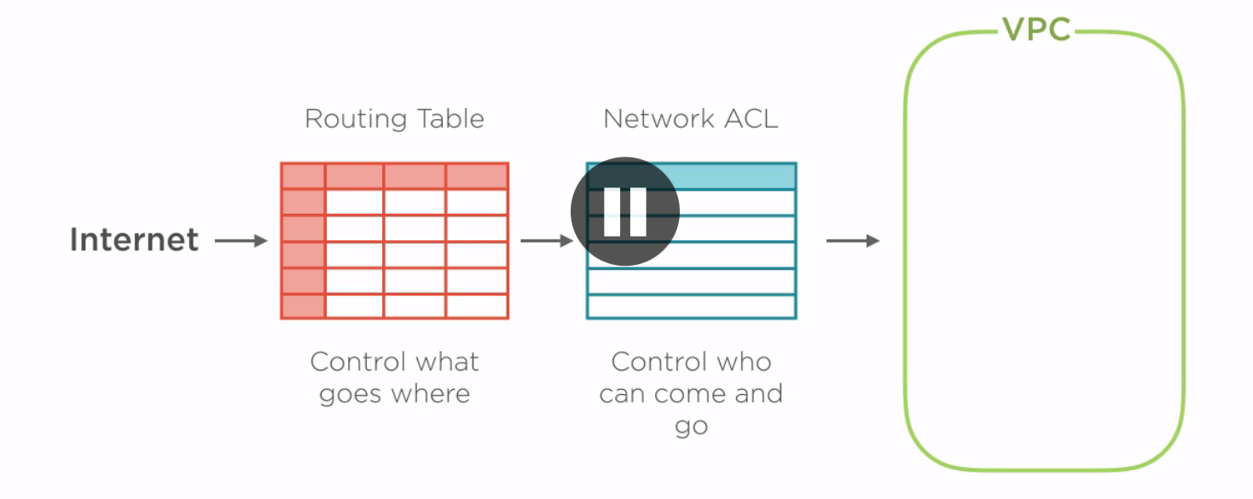
VPC Security

Slide 16
Customize the Network
Create a public facing subnet for your Web servers with internet access
Place backend systems such as database or application servers in a private facing subnet with no internet access
Leverage multiple layers of security ,including security groups and network access control lists

Slide 17
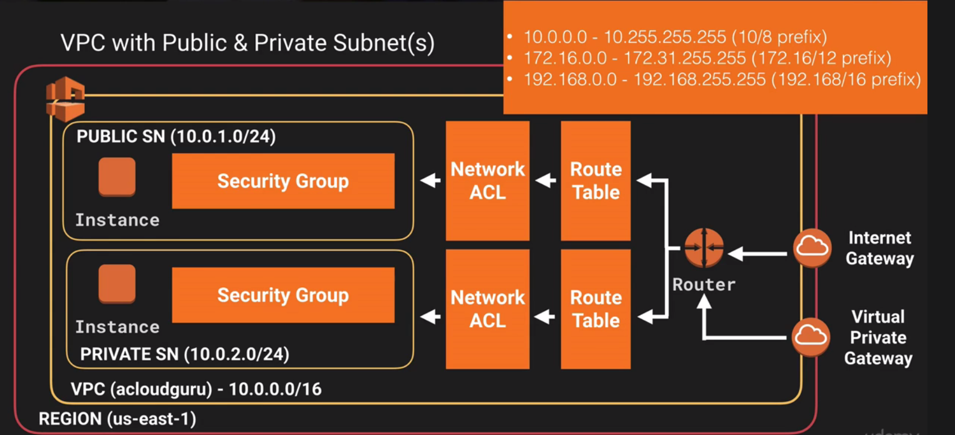
VPC Diagram

Slide 18
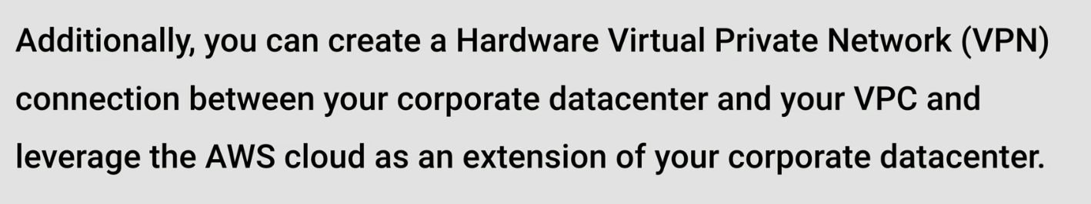
VPC

Slide 19
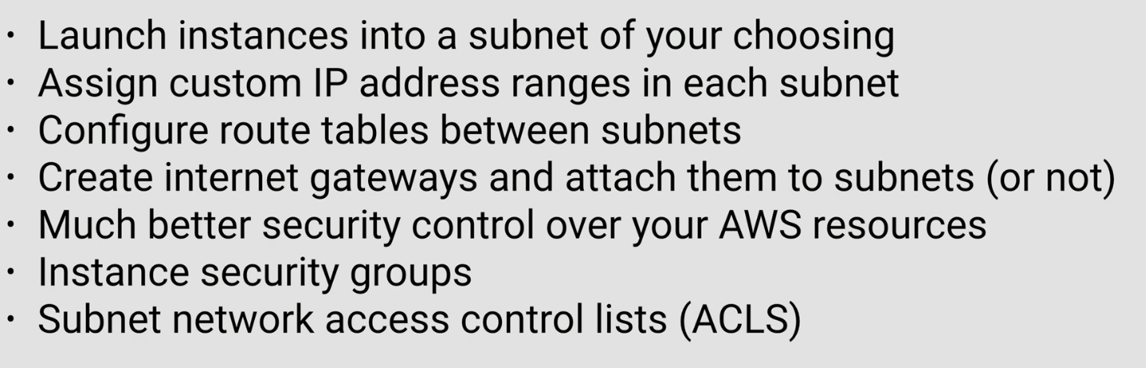
What can you do with a VPC ?

Slide 20
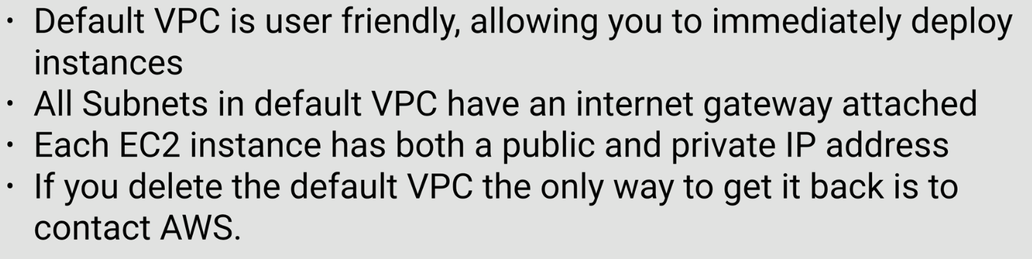
Default VPC Vs Custom VPC

Slide 21
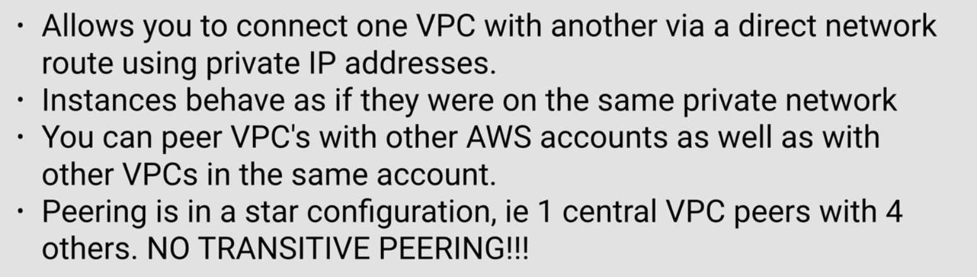
VPC Peering

Slide 22
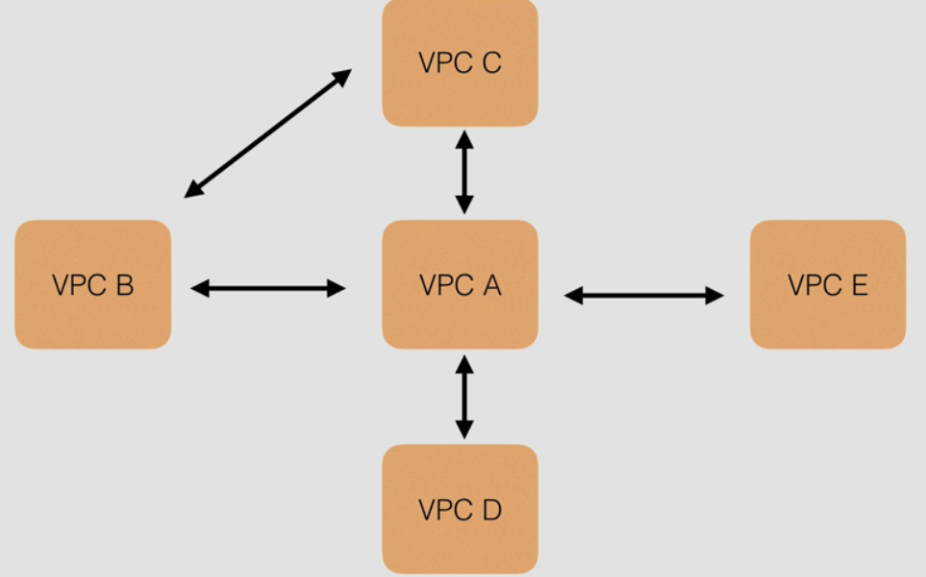
VPC Transitive Peering

Slide 23
Summary
Learnt what is VPC
Customizing the Network
VPC – what can you do with ?
Default VPC vs Custom VPC
VPC Peering
VPC Transitive Peering

